Slide 1
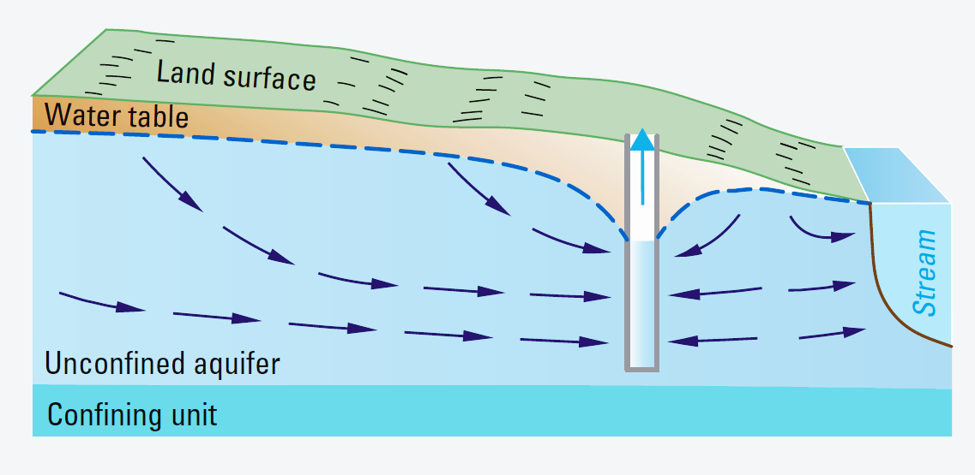
GroMore Project
Advocacy
Group 1 - Amanda, Justin, Vivek, Tesfa

Slide 2
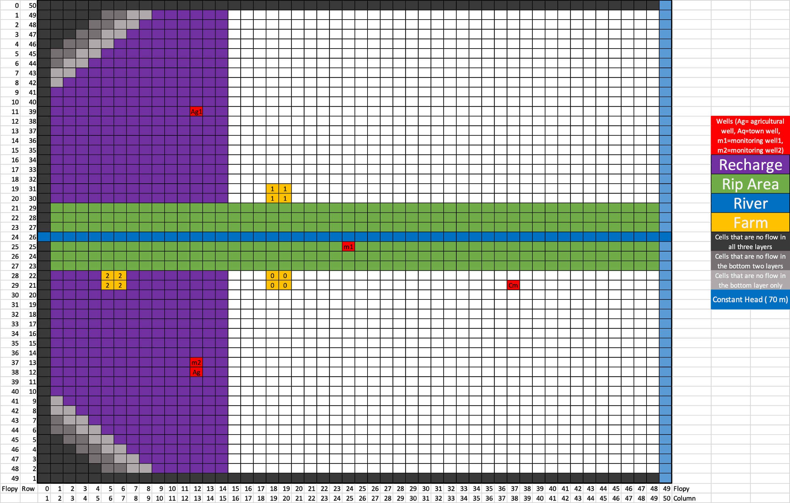
Our Scenario Designs
The Base Model
No change to infrastructure
One run with pistachios, one with wheat
The Reflected Model
Reflect the farm and well to the other side of the river to avoid infringing on AS community well
One run with pistachios, one with wheat
The Moving Field Model
The field moves further into the recharge zone, closer to losing sections of stream to avoid drawing water from the stream and any potential contamination
One run with pistachios, one with wheat

Slide 3
Close-up: The Domain

Slide 4
GroMore is recommending the Base Model as a way to save money and time for community members, activists and investors.
We aim to prove that:
Crop choice has minimal impact
Moving the field has minimal impact
Moving the well has minimal impact

Slide 5
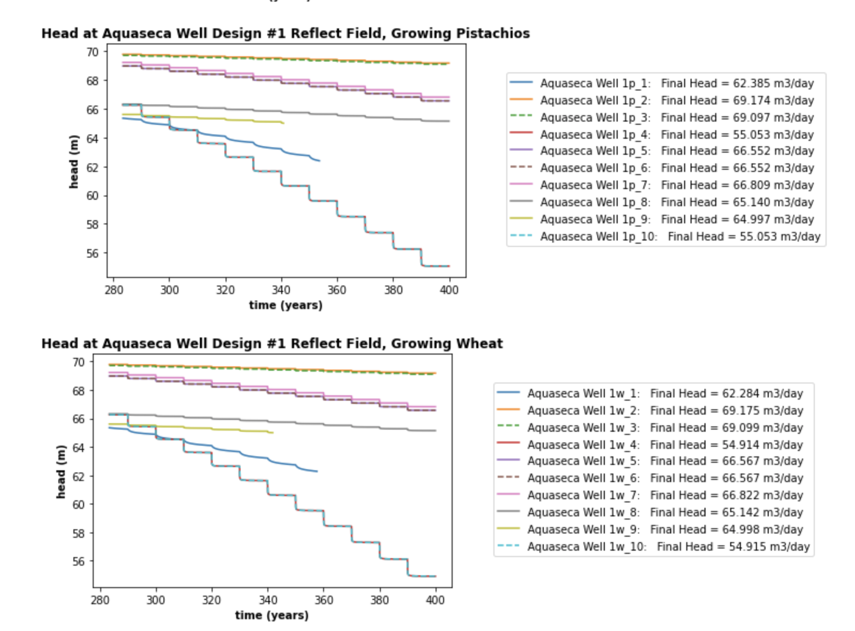
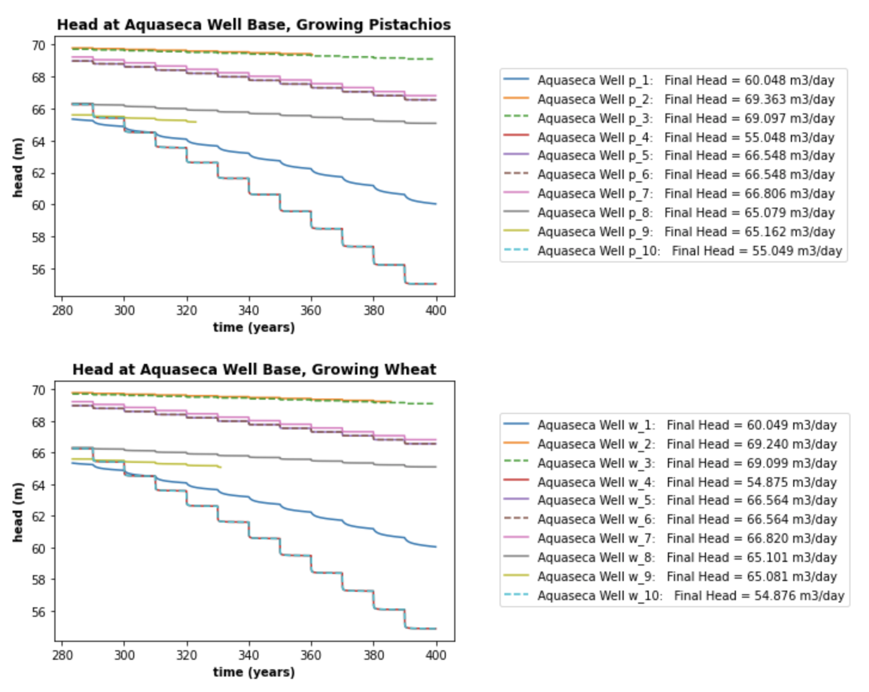
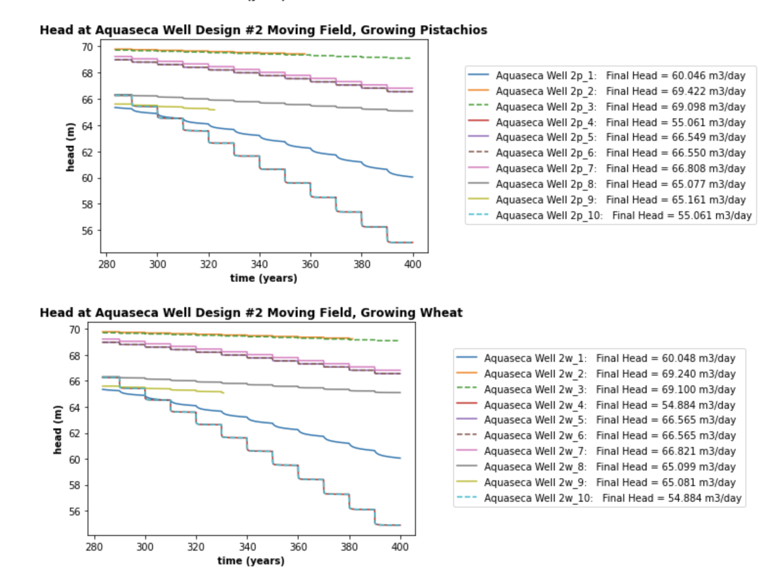
The Community Well: Base, reflected, moved

Slide 6
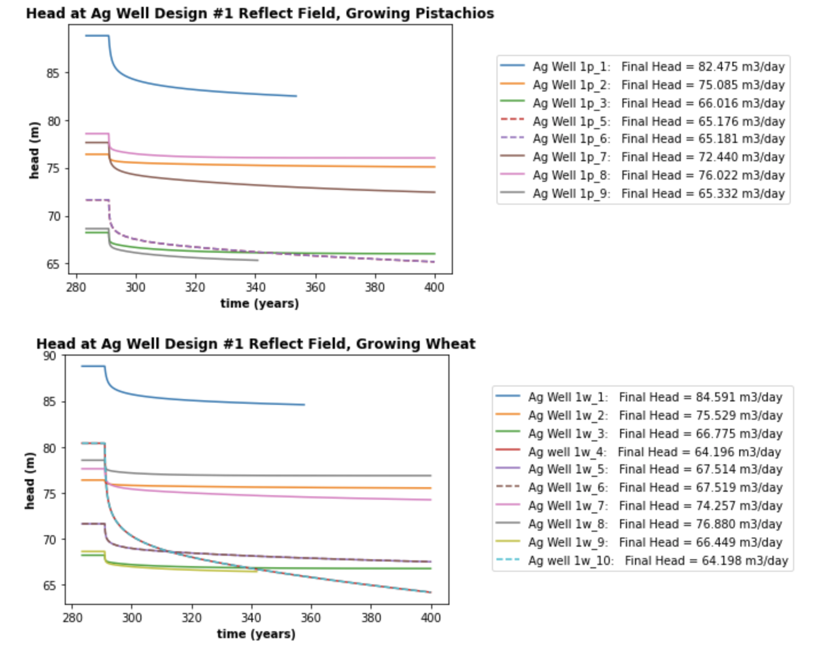
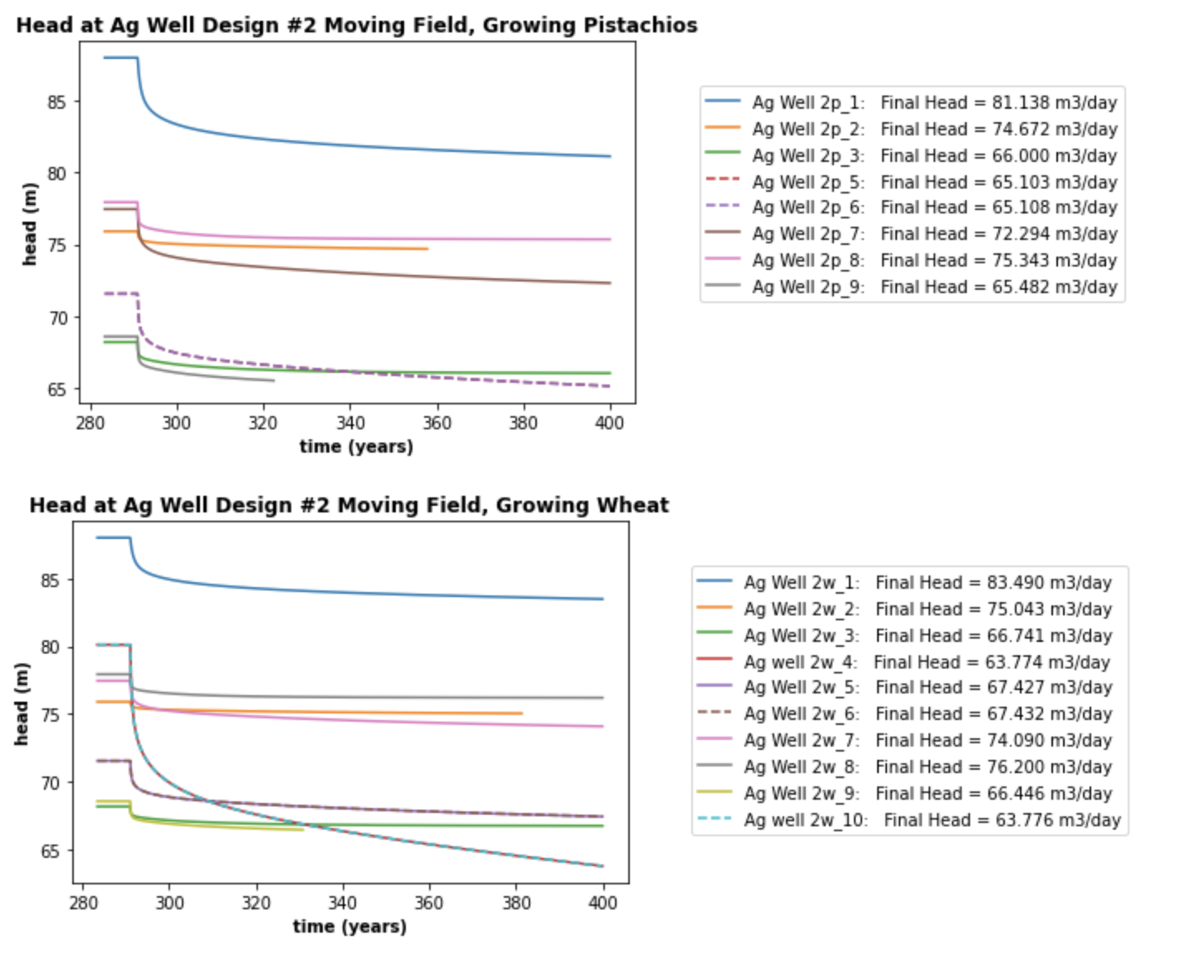
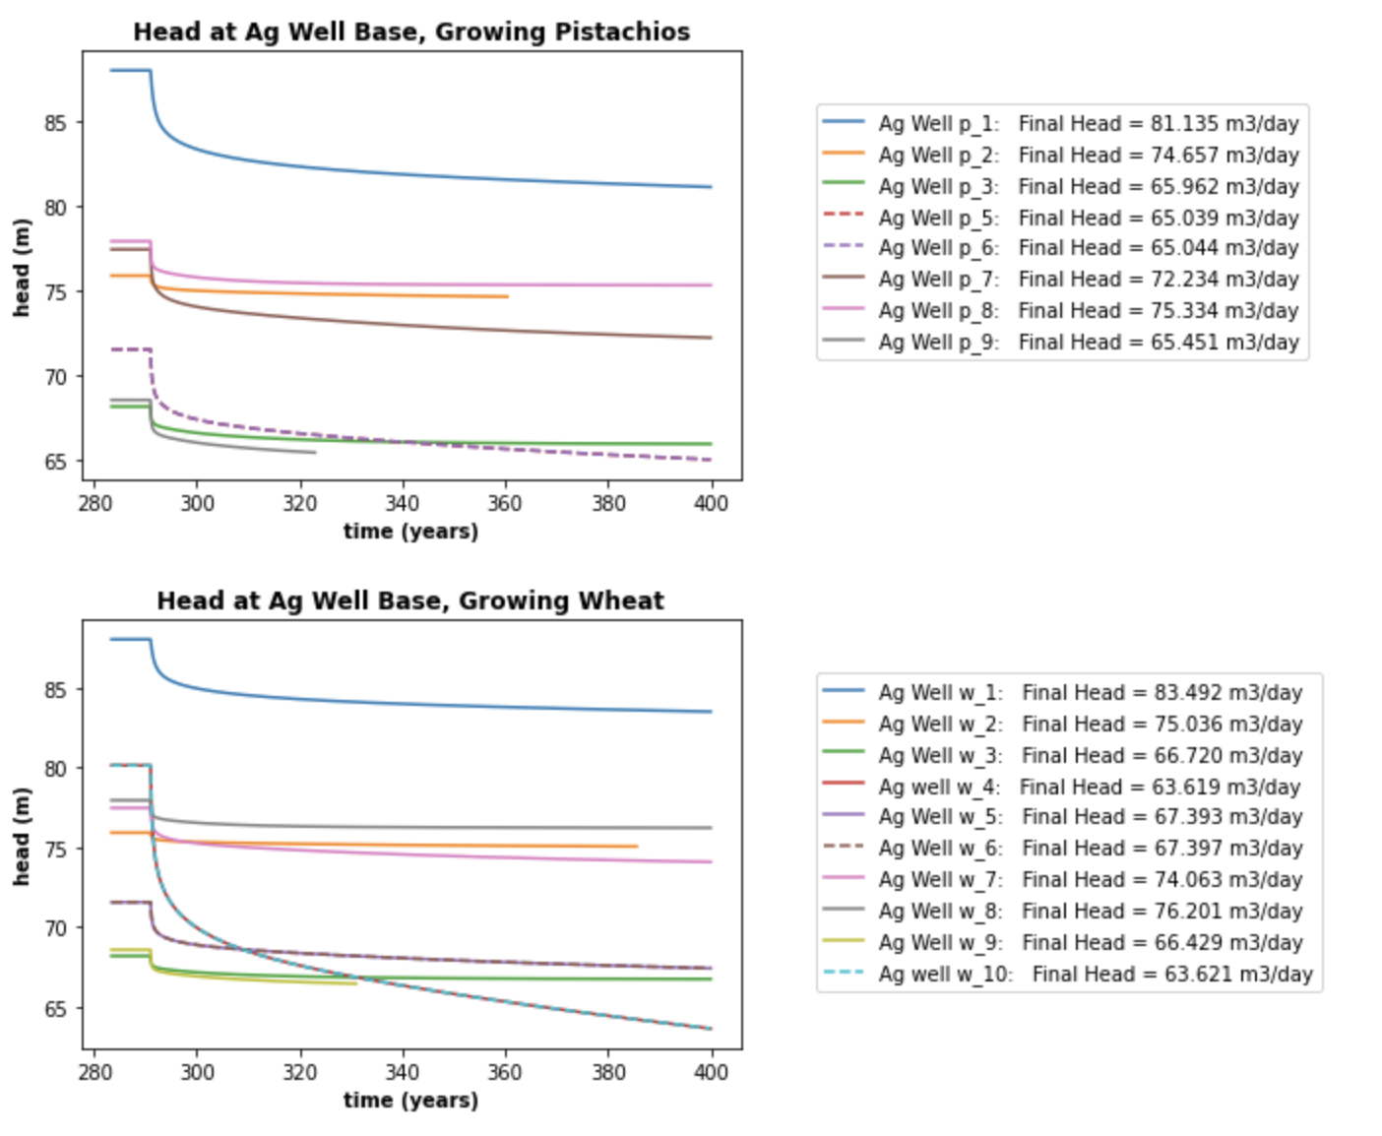
The Agricultural Well: Base, reflected, moved

Slide 7
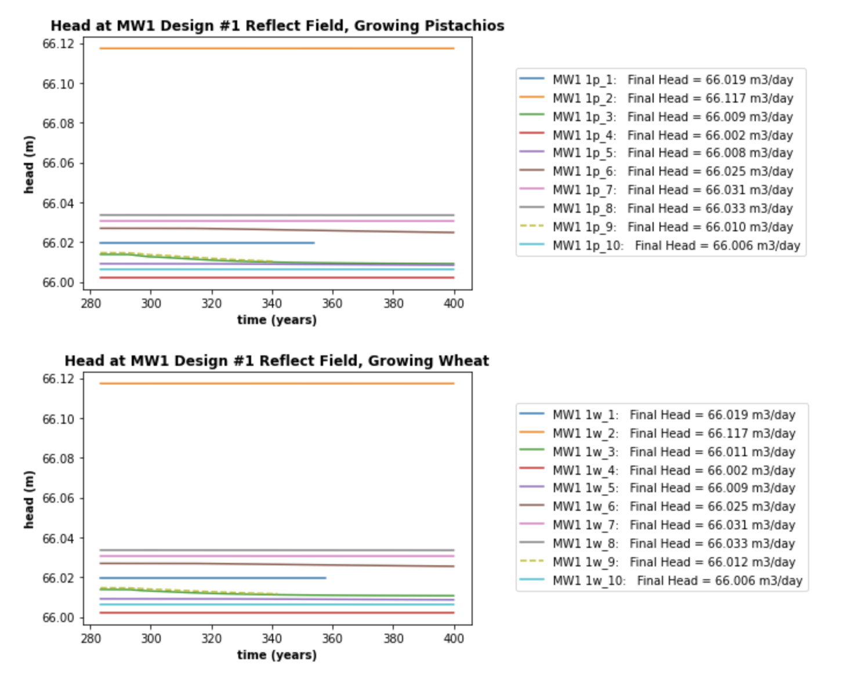
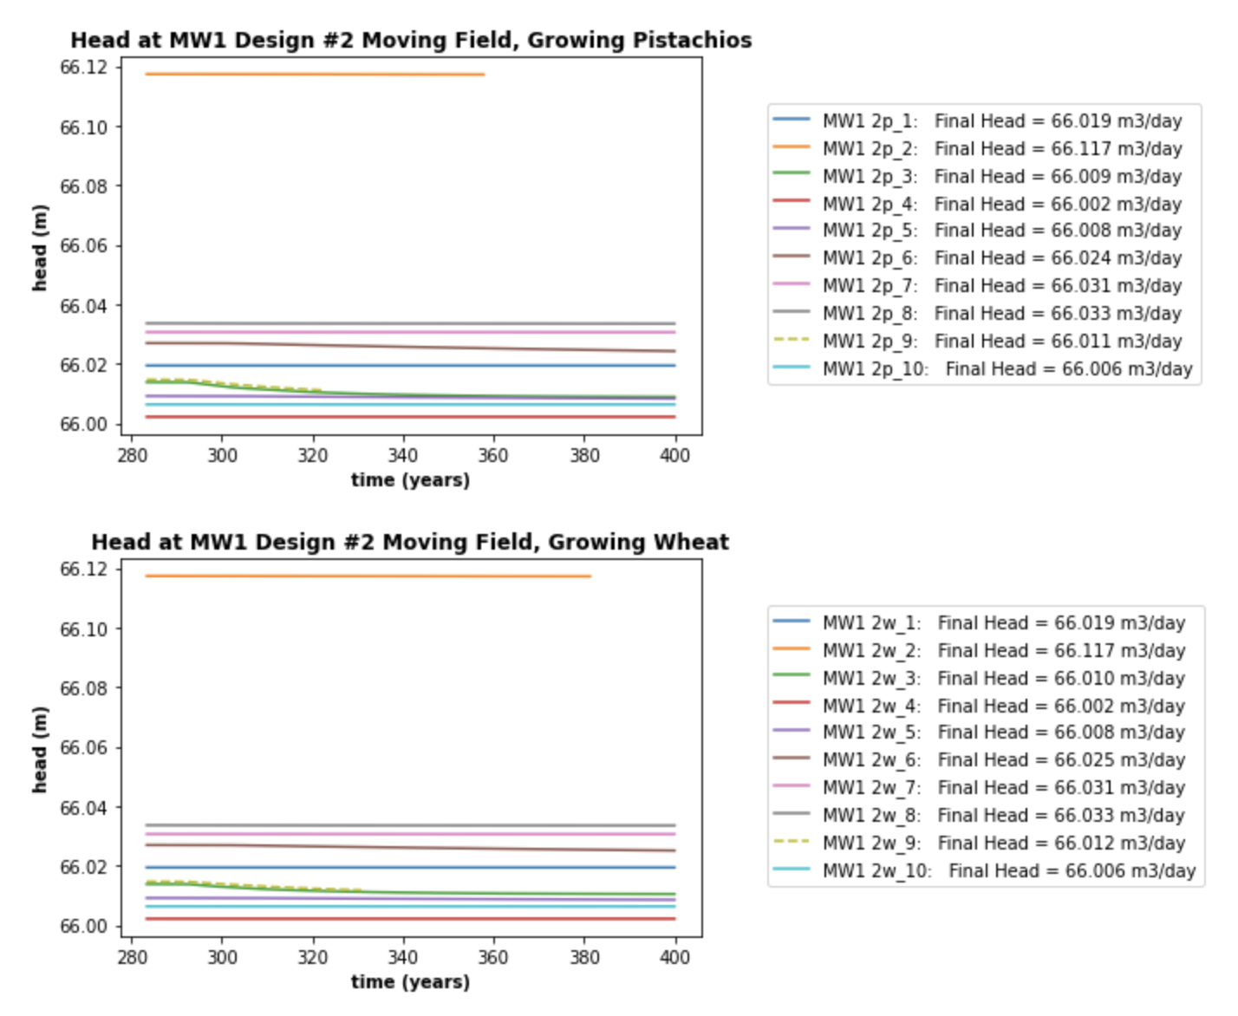
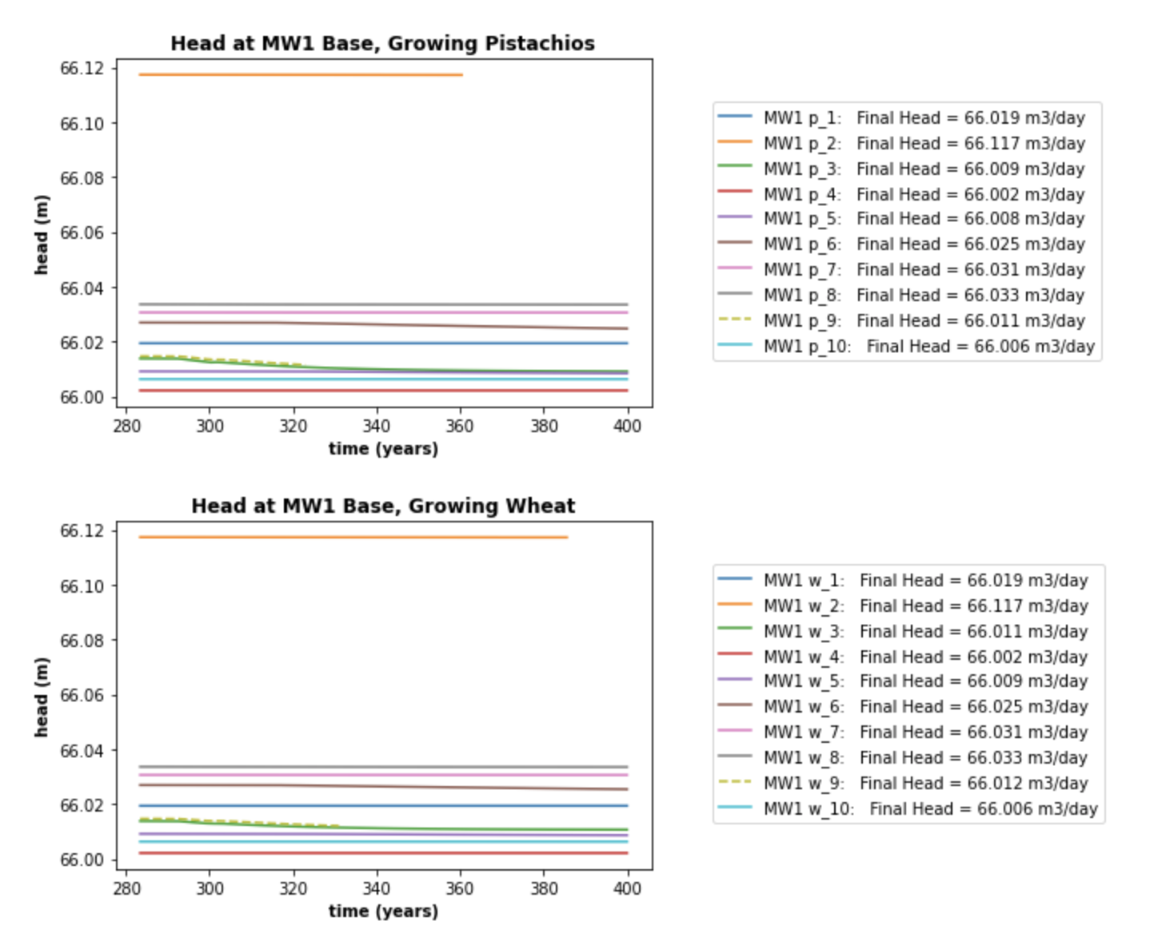
Monitoring Well 1: Base, reflected, moved

Slide 8
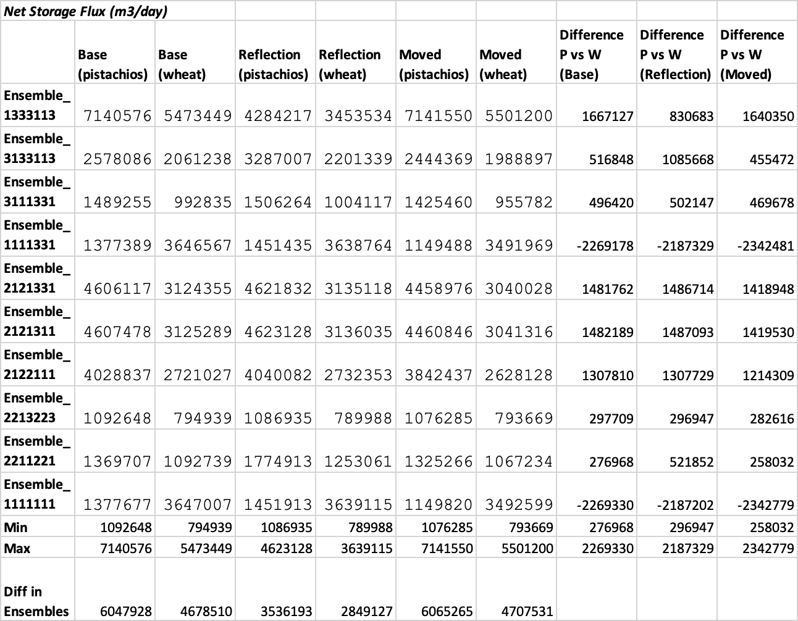
Net Storage Changes: Pistachios vs. Wheat
There is only one case (reflected wheat) where the difference in pistachios vs. wheat is even close to the differences we see in ensemble runs
The impact of pistachio vs. wheat strongly depends on the ensemble
We see greater storage losses from wheat (4 and 10) - this is likely an error based on head plots

Slide 9
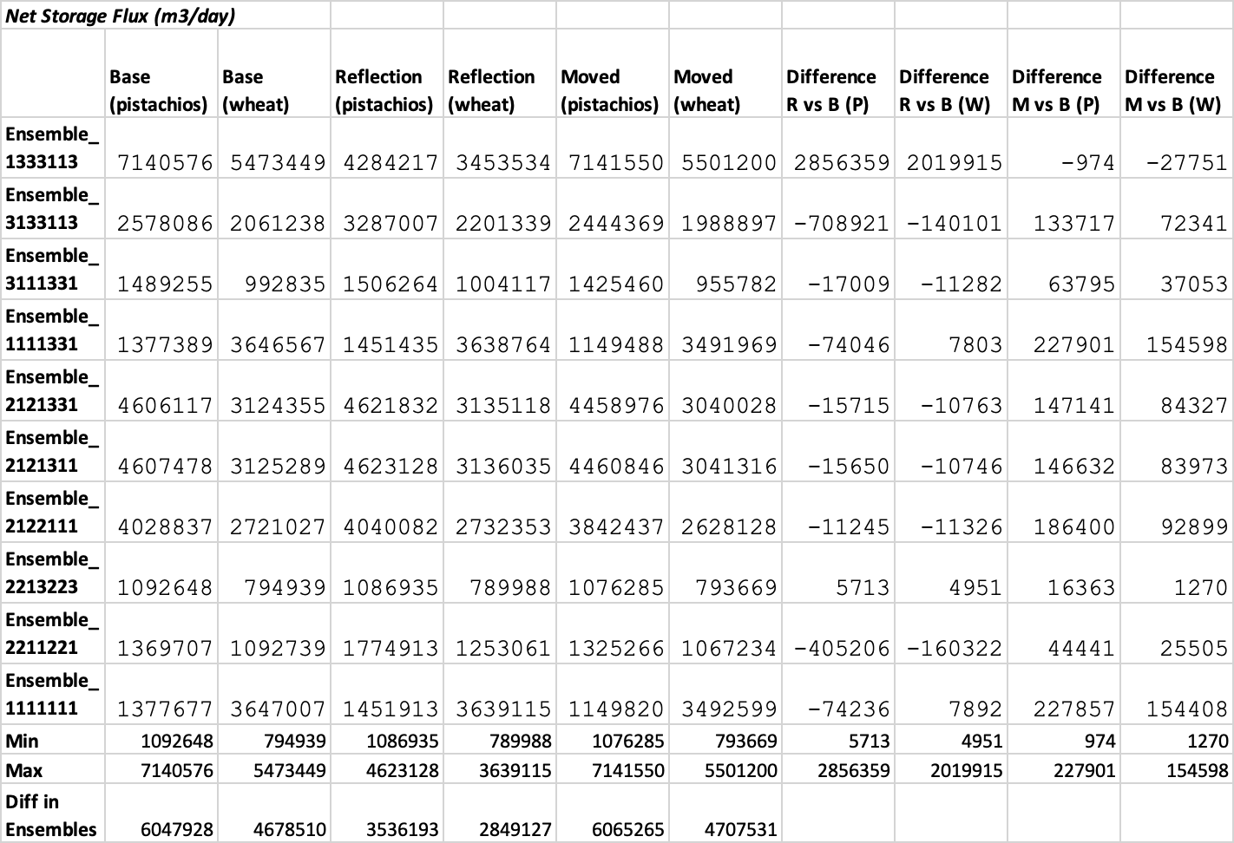
Net Storage Changes: Baseline vs. Reflected vs. Moved
The different designs depend very strongly on the ensemble, some differences are almost nothing while some are very large
Again, ensemble differences are almost always greater

Slide 10
The Case of River Leakage
Conductance has decreased by a factor of 1000 at minimum and 10000 at maximum
Not an extremely strong water source as before
Ensembles show that other factors such as K are a stronger indicator of if water moves from the river into the domain in significant quantities

Slide 11
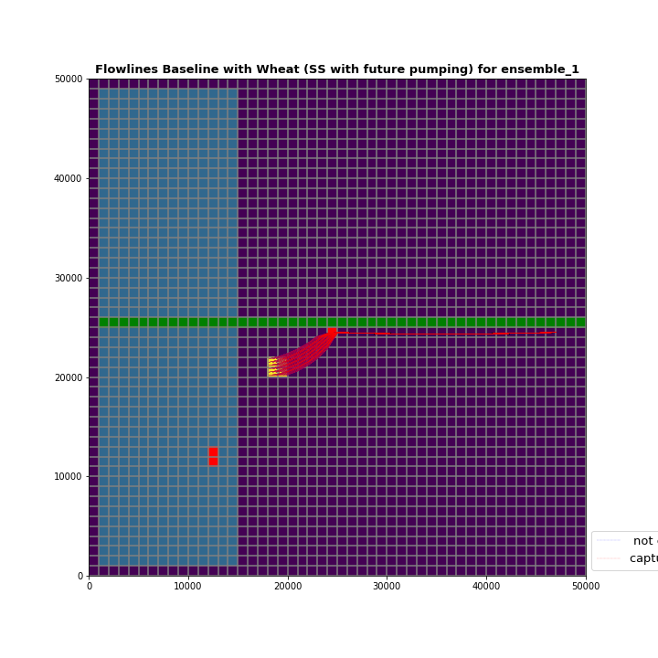
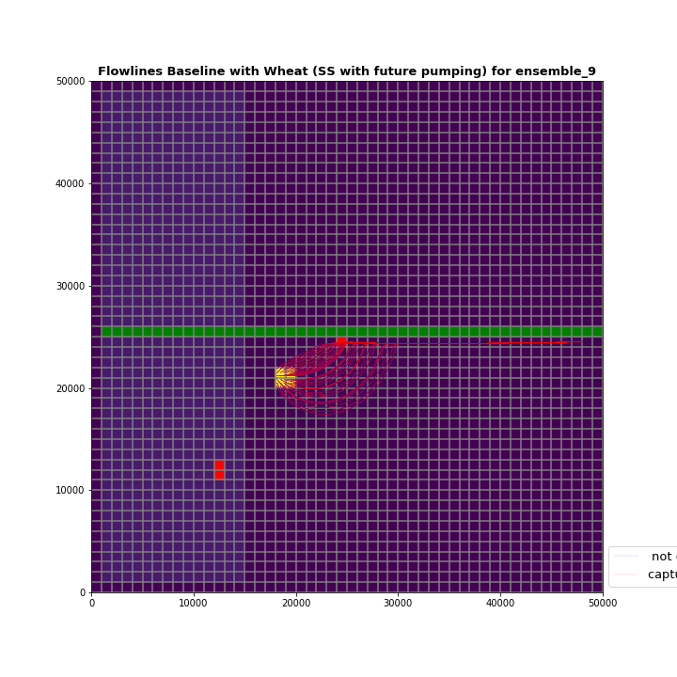
Particle Tracking - Baseline
While there is irrigation water going into the river in baseline design…
Right - 3133113 (Lack of Water High Conductivity)
Far Right - 1111111 (Lot of water Low Conductivity)

Slide 12
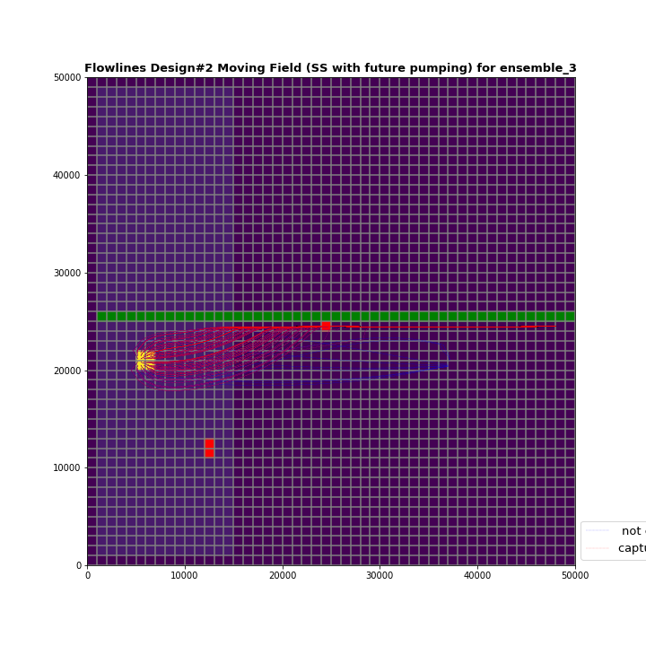
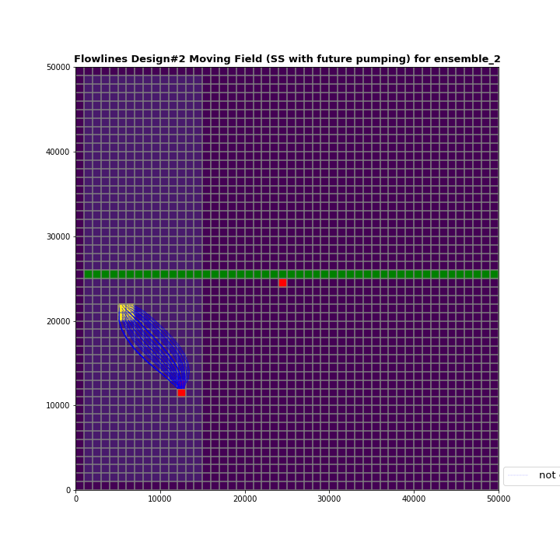
Particle Tracking - Moved Field: Important Cases
Only a change in one parameter causes a change in capture:
Right - 1111331
Far Right - 3111331
For Pistachios 4/10 ensembles result in capture of irrigation water by Ag well

Slide 13

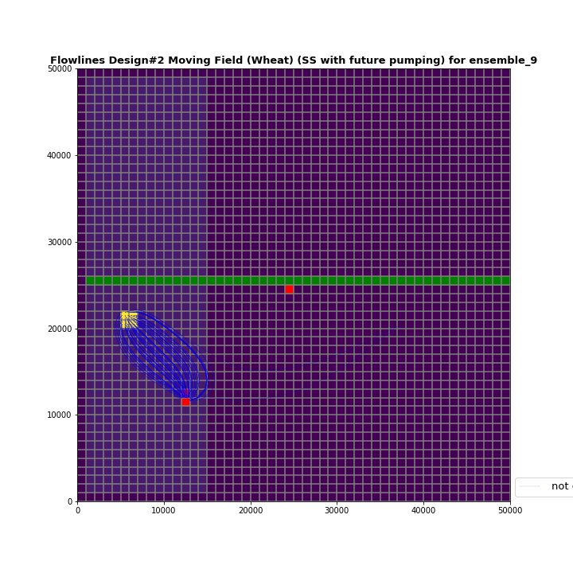
Particle Tracking - Moved Field: Important Cases
When using Wheat the capture by Ag well becomes even more significant
Right - E_9 Pistachios
Far Right -E_9 Wheat
For Pistachios 4/10 ensembles result in capture of irrigation water by Ag well
For Wheat 6/10 ensembles result in capture of irrigation water by Ag well

Slide 14
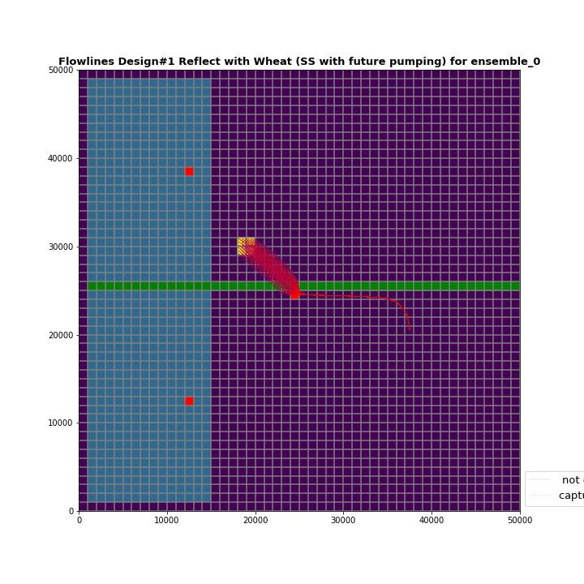
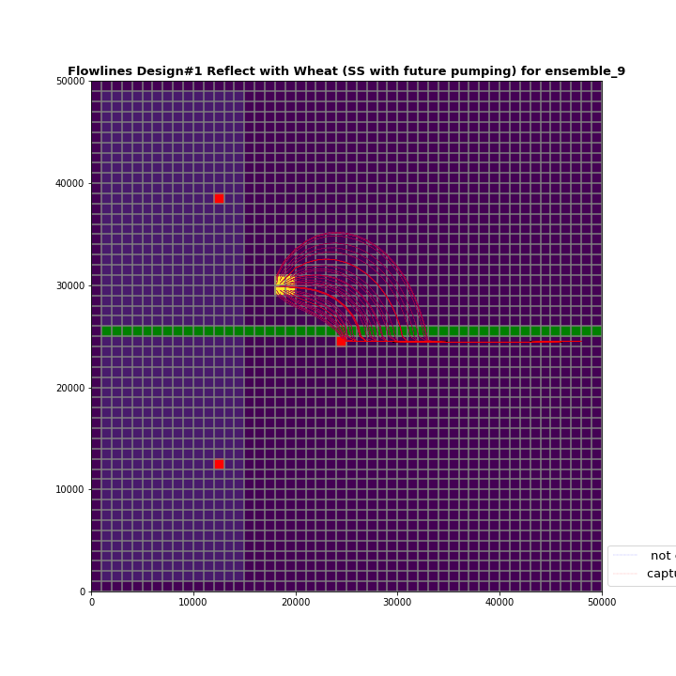
Particle Tracking - Reflection: Important Cases
Being on the other side does not not help much

Slide 15
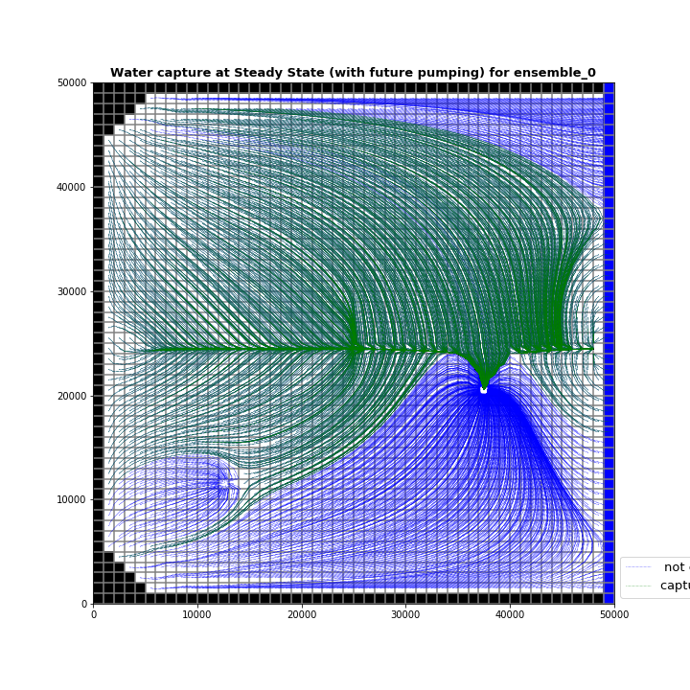
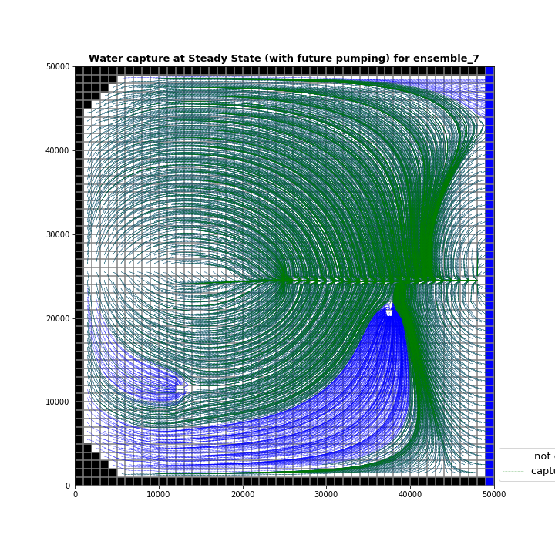
Capture by the two wells

Slide 16
Conclusion
Our design choices as well of choice of crop seem to have little significant impact on the metrics we care about (heads in the community well, storage changes, contamination) especially when compared with the differences resulting from parameter choice
Recommendation:
Agricultural project continues as planned, unaltered
However if proof can be given in a timely manner that hydrologic properties are such that we see agricultural field recharging into the pumping well, we will consider moving the field
Investment is made into researching the hydrologic properties of the area, particularly hydraulic conductivity so that the sustainability of future projects can be better determined
GroMore insists that it would not like to let go of crop choice flexibility in any case

